Slide 2
Dragonfly: Intro, Updates and AI model distribution in the Kuaishou
Wenbo Qi – Ant Group
Zekun Liu - Kuaishou

Slide 3

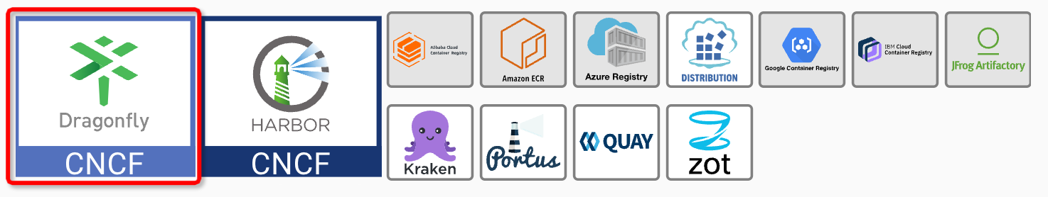
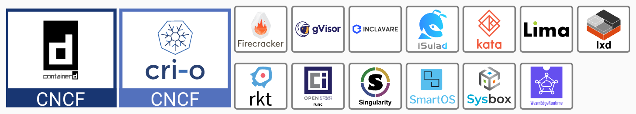







Introduction
What is Dragonfly？
Provide file distribution and image acceleration
based on p2p technology.
Container Registry
Dragonfly is an open source P2P-based file distribution and image acceleration system. It is hosted by the Cloud Native Computing Foundation (CNCF) as an Incubating Level Project. Its goal is to tackle all distribution problems in cloud native architectures.
Container Runtime

Slide 4
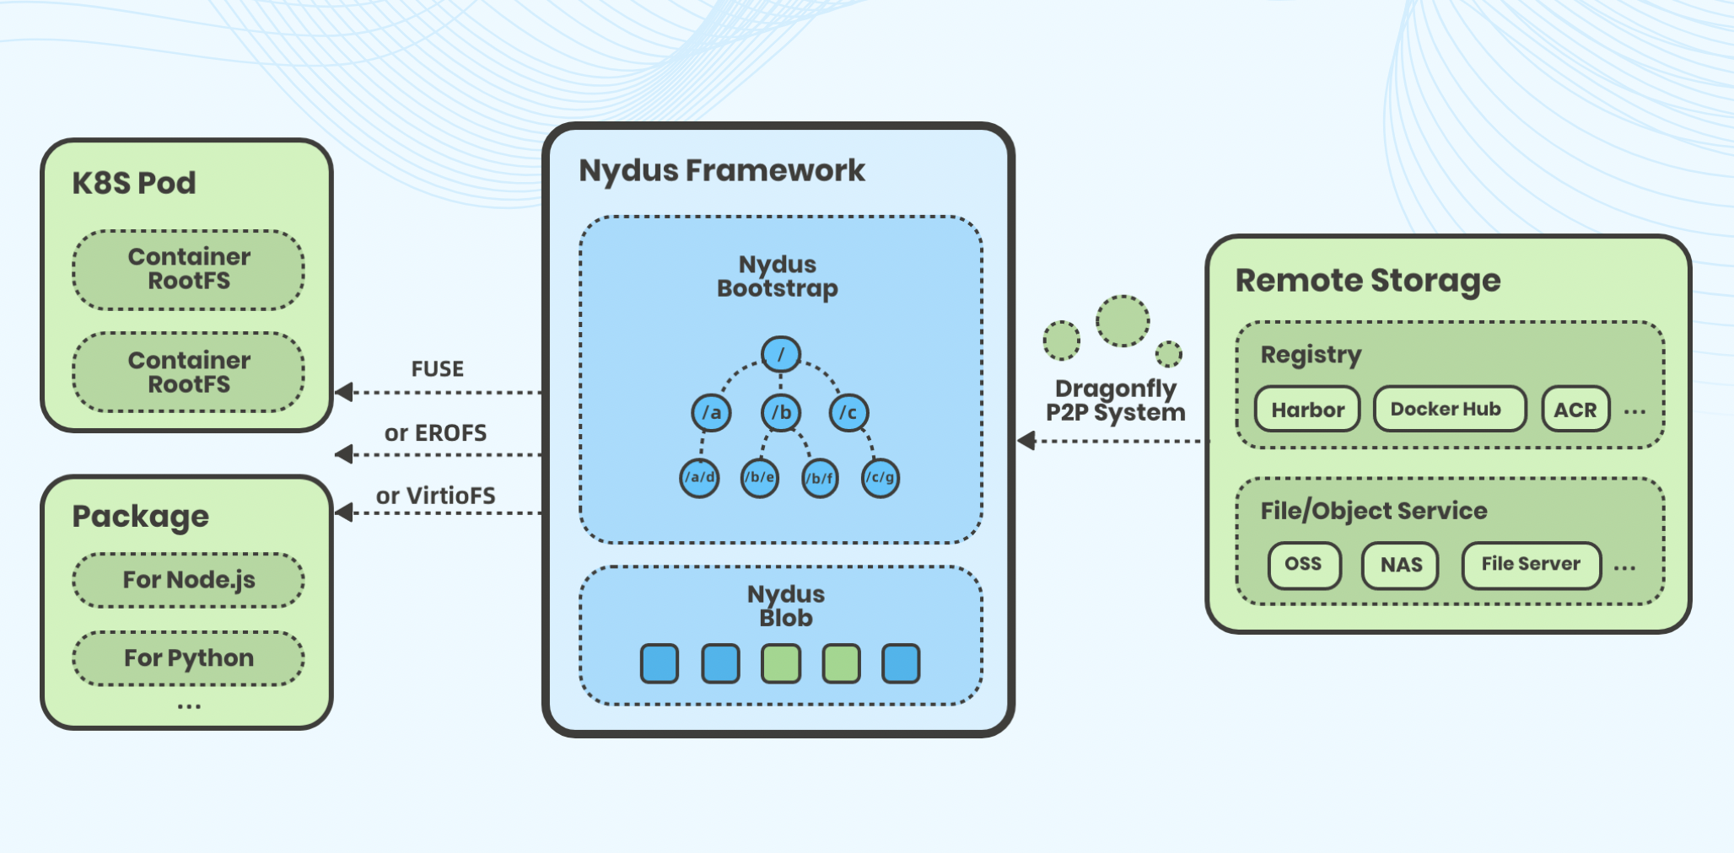


Introduction
What is Nydus？
Nydus implements a content-addressable file system on the RAFS format, which enhances the current OCI image specification by improving container launch speed, image space and network bandwidth efficiency, and data integrity.

Slide 5
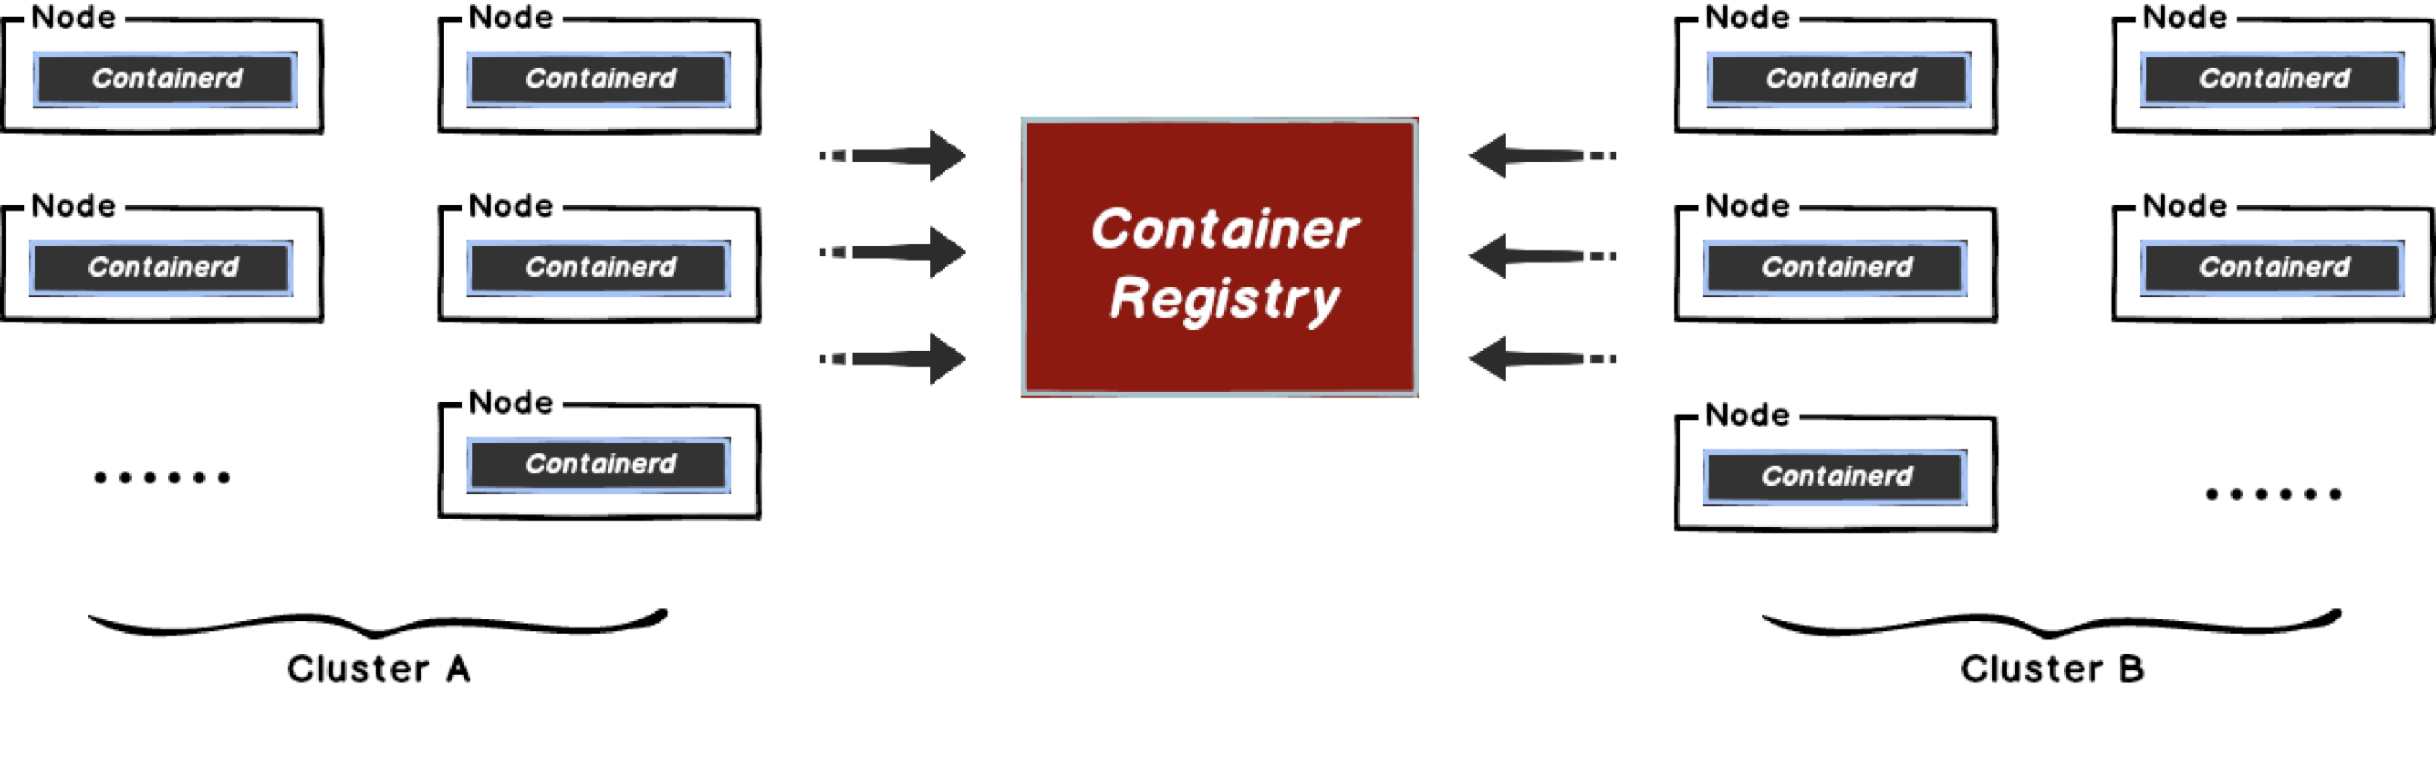
Why Use Dragonfly?
Distribtion File
In large-scale clusters, pulling files from the origin site often faces bandwidth limitations. How to maximize the use of cluster intranet bandwidth has become a problem worth exploring.

Slide 6
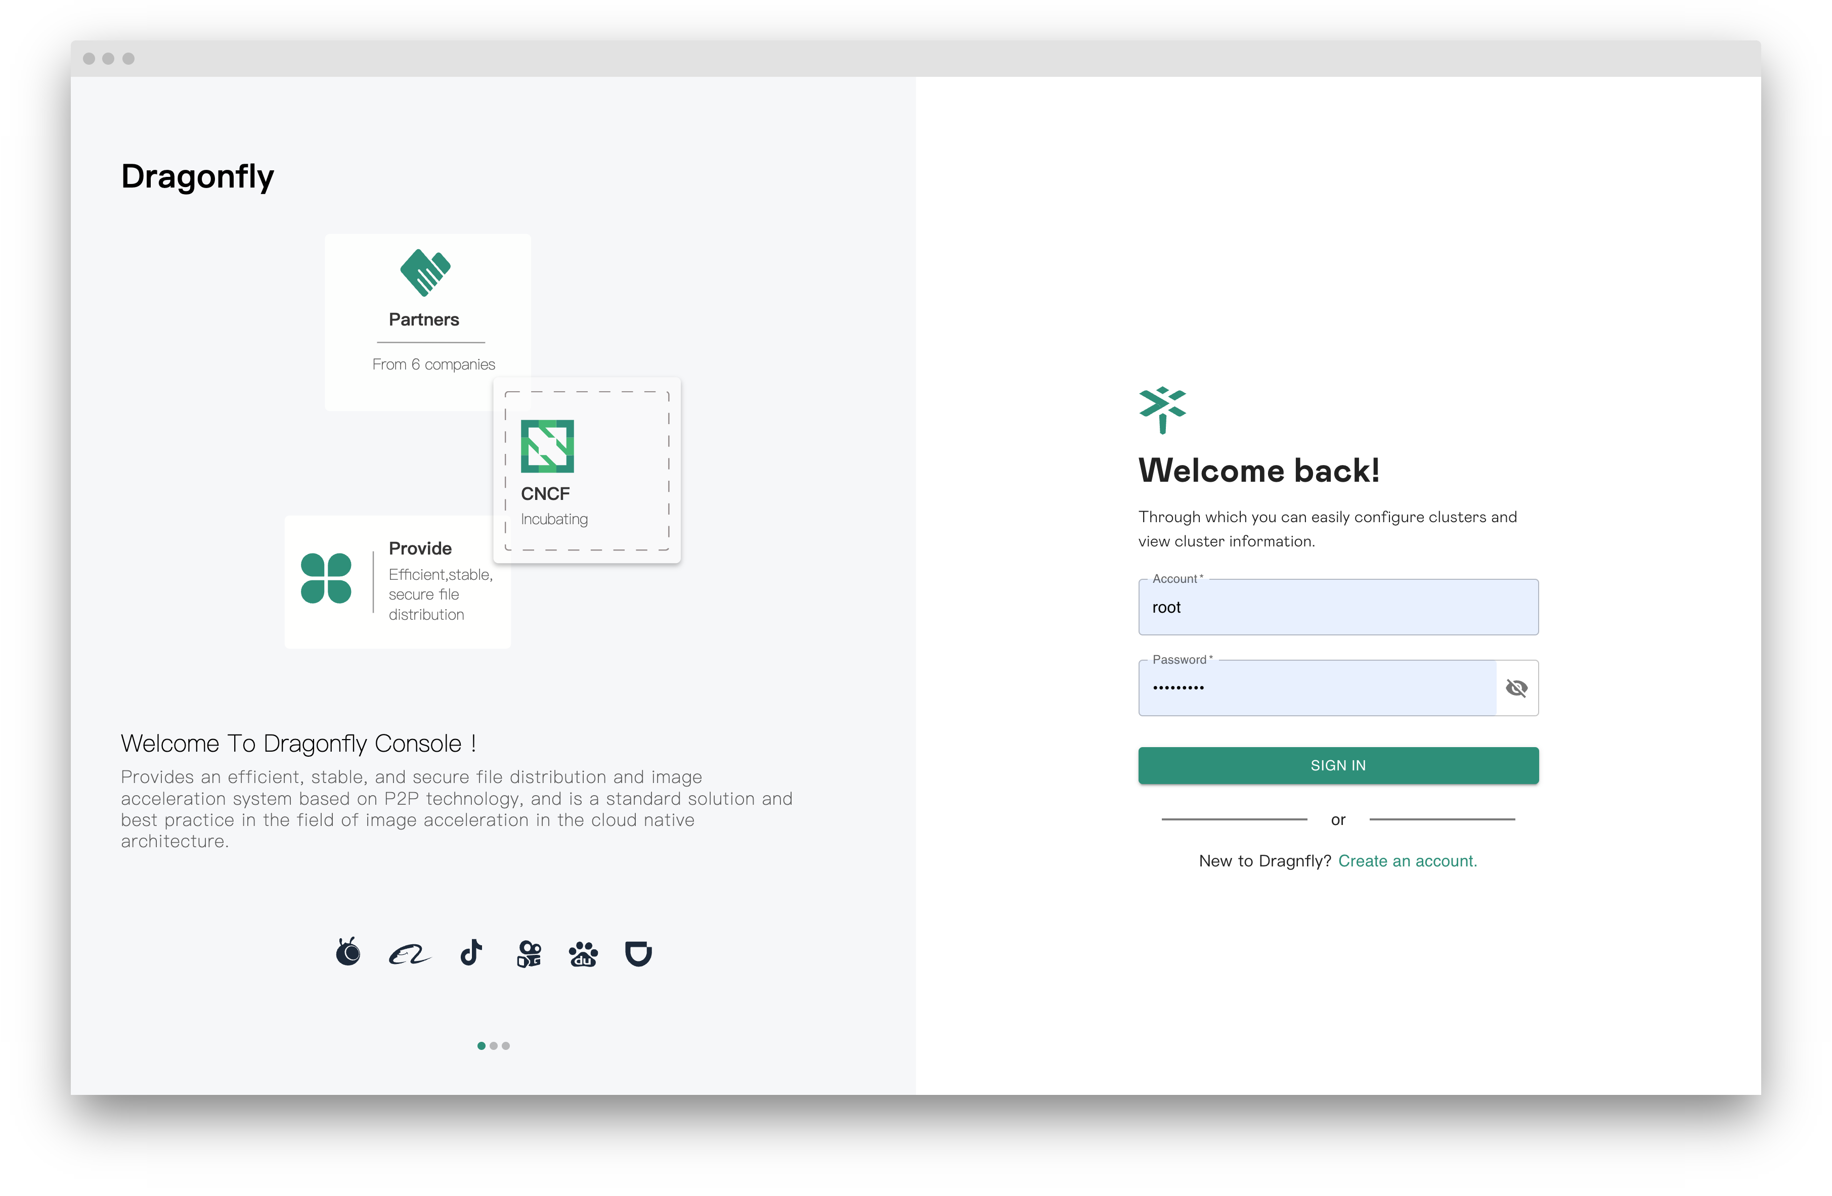
Exciting Updates
Console V2.0
Rewritten the visual console page to improve user experience.
The overall operating process is more clearly defined.
Simpler multi-cluster initialization and deployment operations.
Reference
Console usage documentation:
https://d7y.io/docs/next/reference/manage-console
Multi-cluster deployment documentation:
https://d7y.io/docs/next/getting-started/quick-start/multi-cluster-kubernetes/

Slide 7
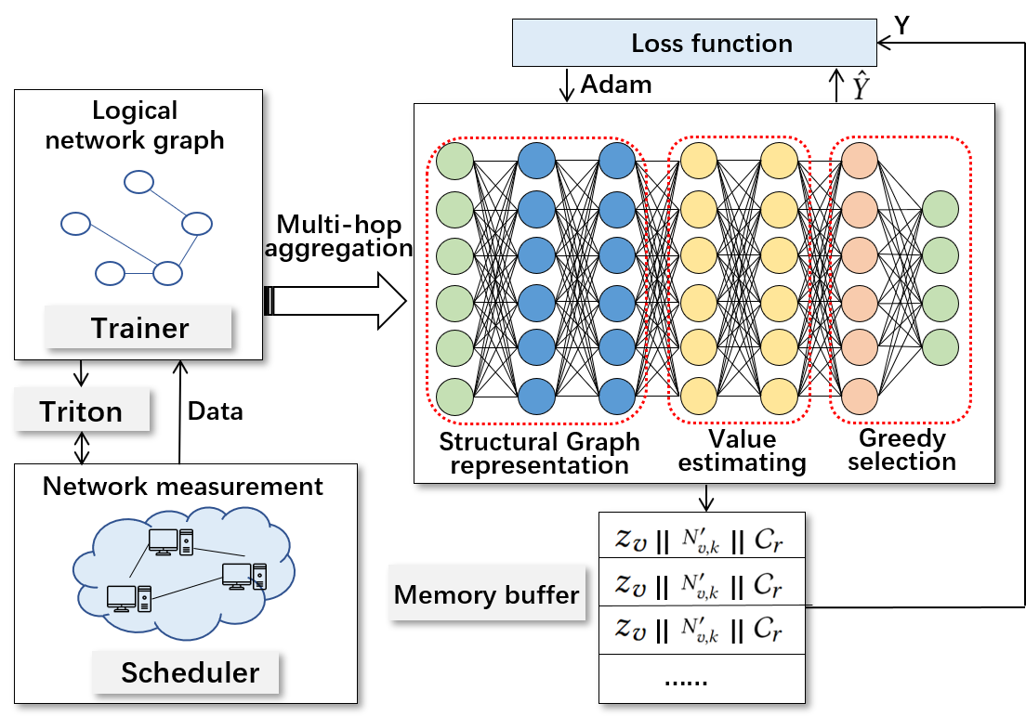
Exciting Updates
Intelligent Scheduling
Construct Network Graph data based on Probe data between Peers and train the Graph Representation (GNN) model.
Reference
Inductive Representation Learning on Large Graphs:
https://arxiv.org/pdf/1706.02216

Slide 8
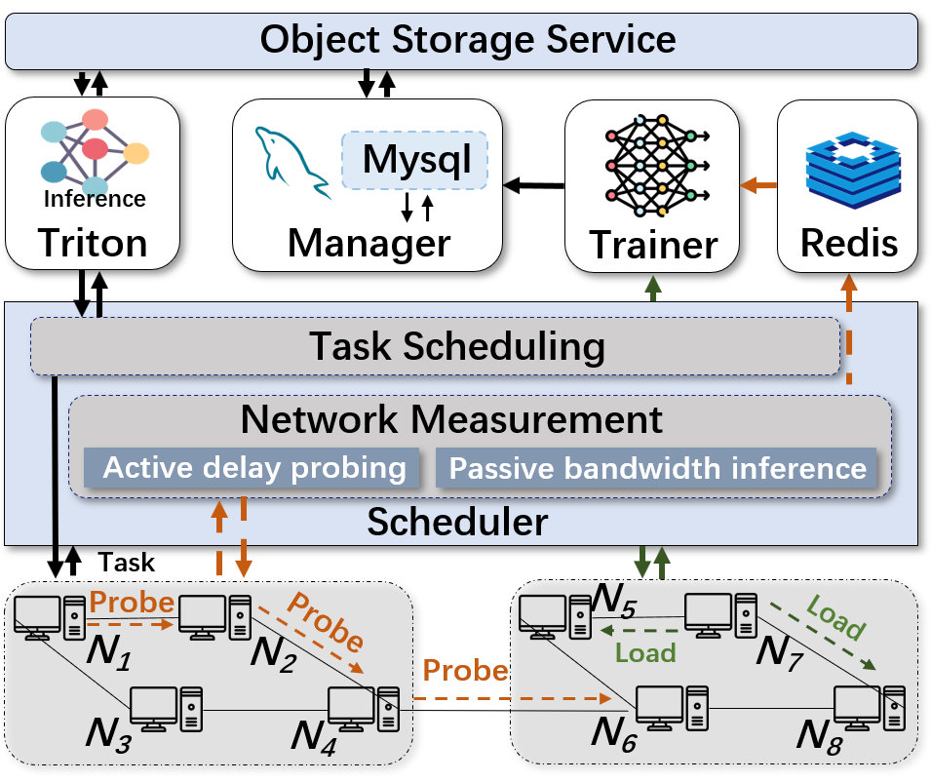
Exciting Updates
Intelligent Scheduling
Traning is divided into two parts: MLP and GNN.
Part of the GNN training set is based on Network Graph data composed of Probes between Peers.
Part of the MLP training is based on historical download record data between peers.
Inference is also divided into two models: MLP and GNN, and both are based on the Triton Server framework for inference services.

Slide 9
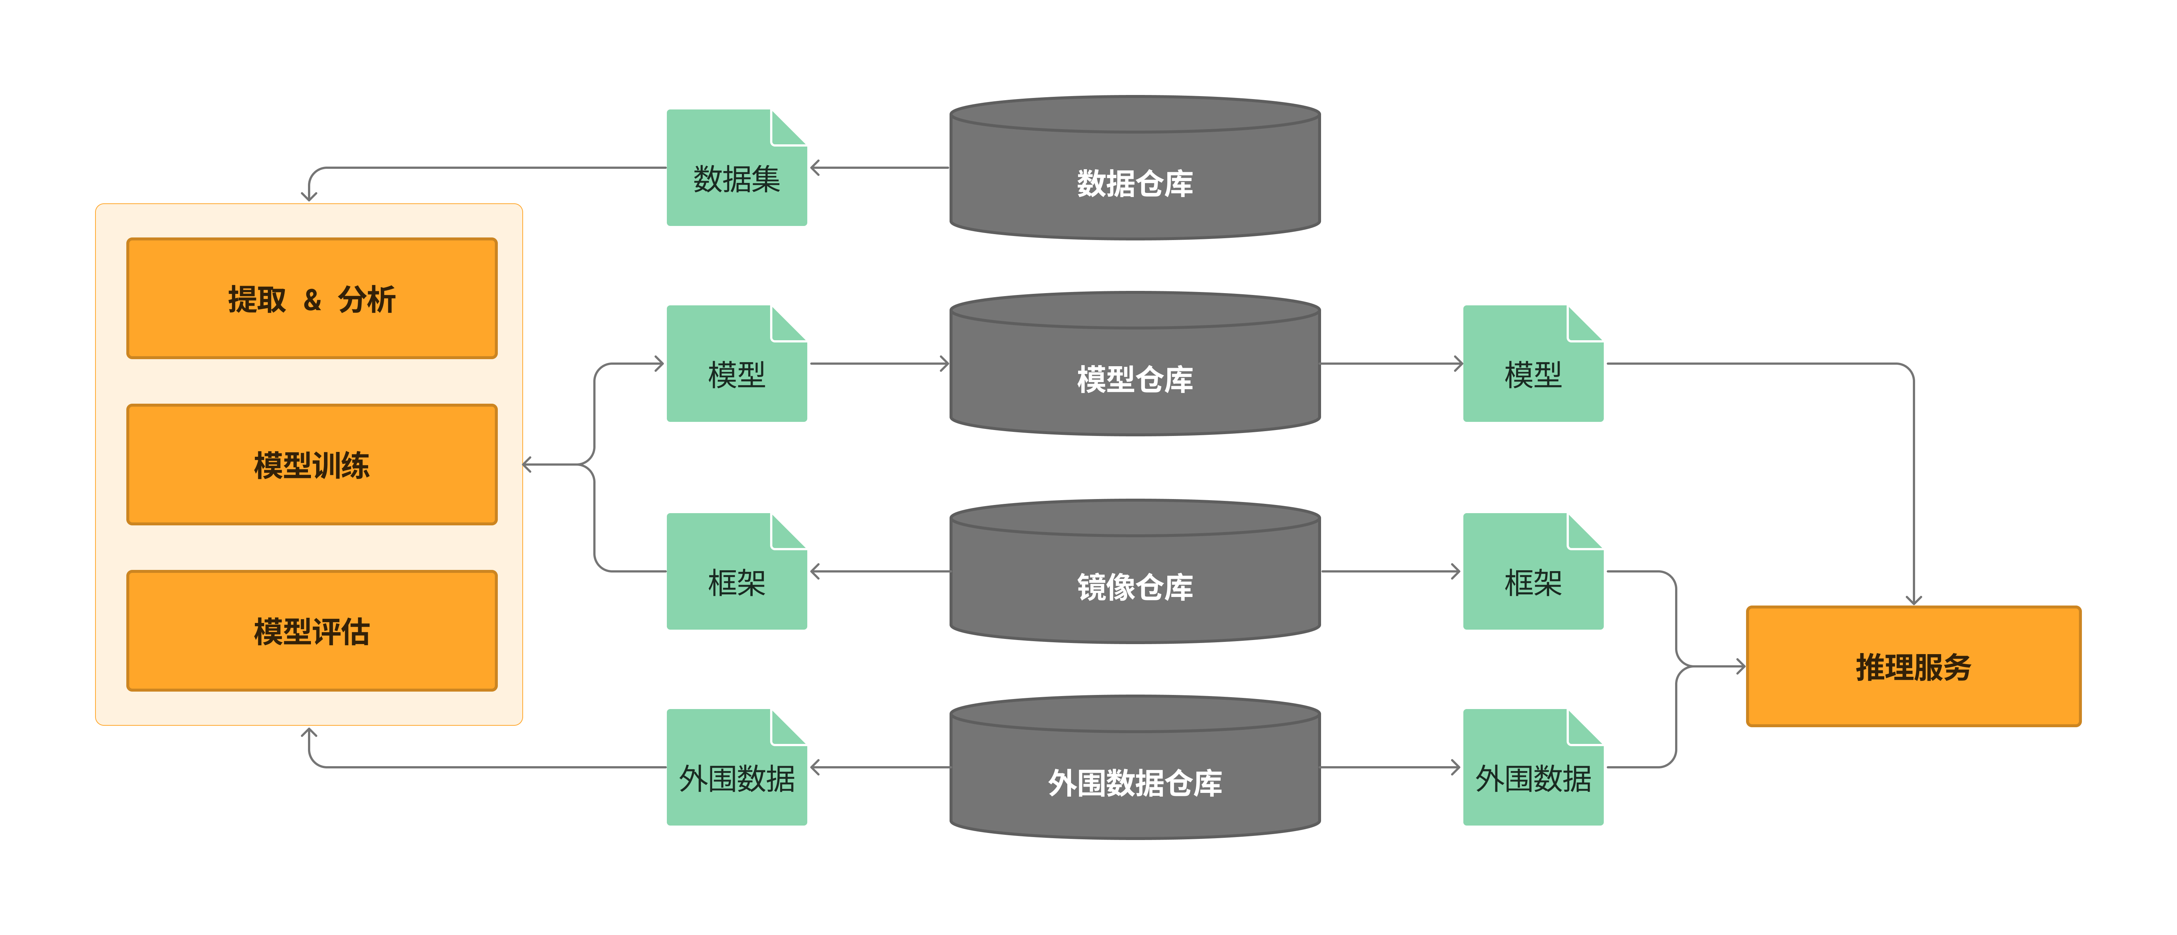
Exciting Updates
AI Data Distribution

Slide 10
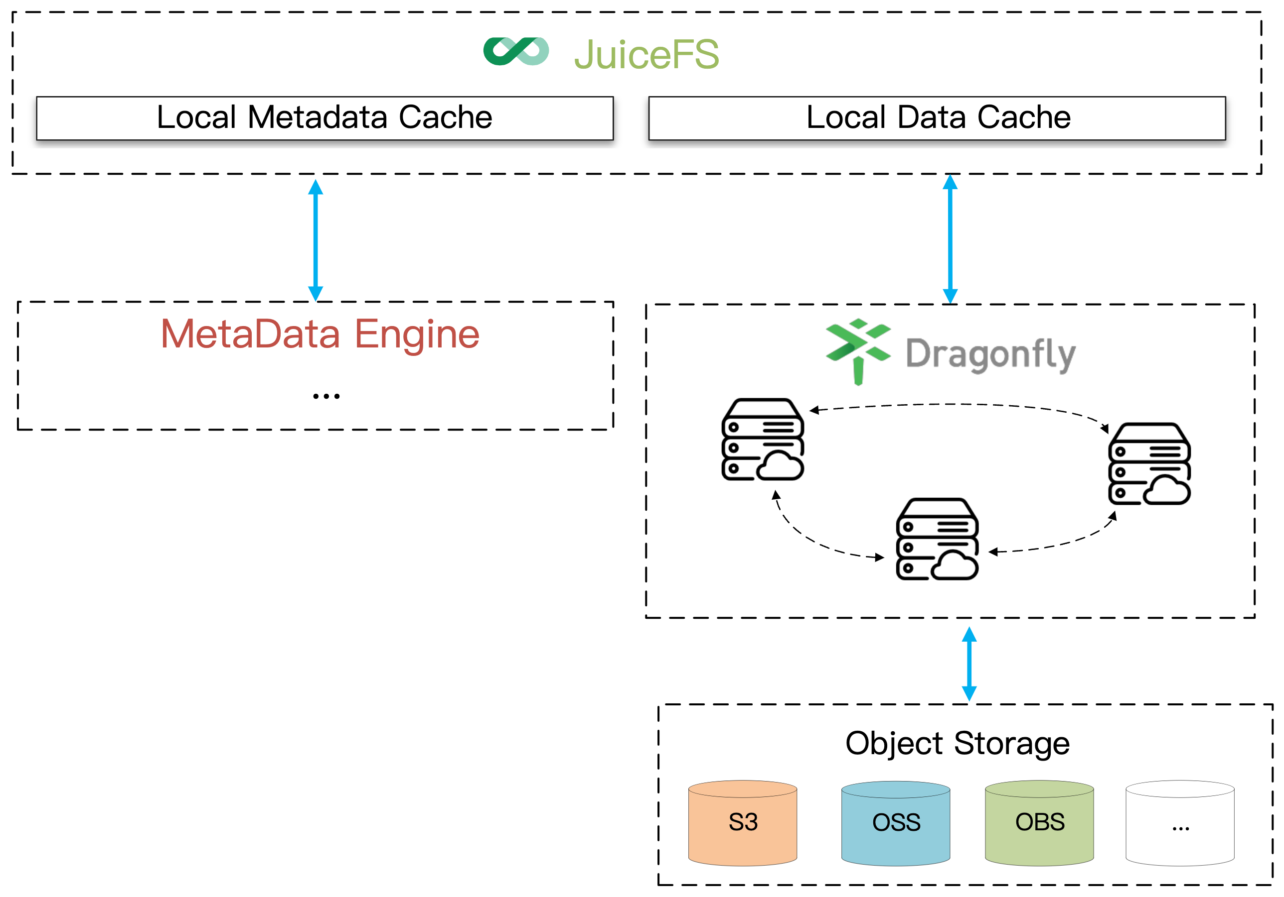
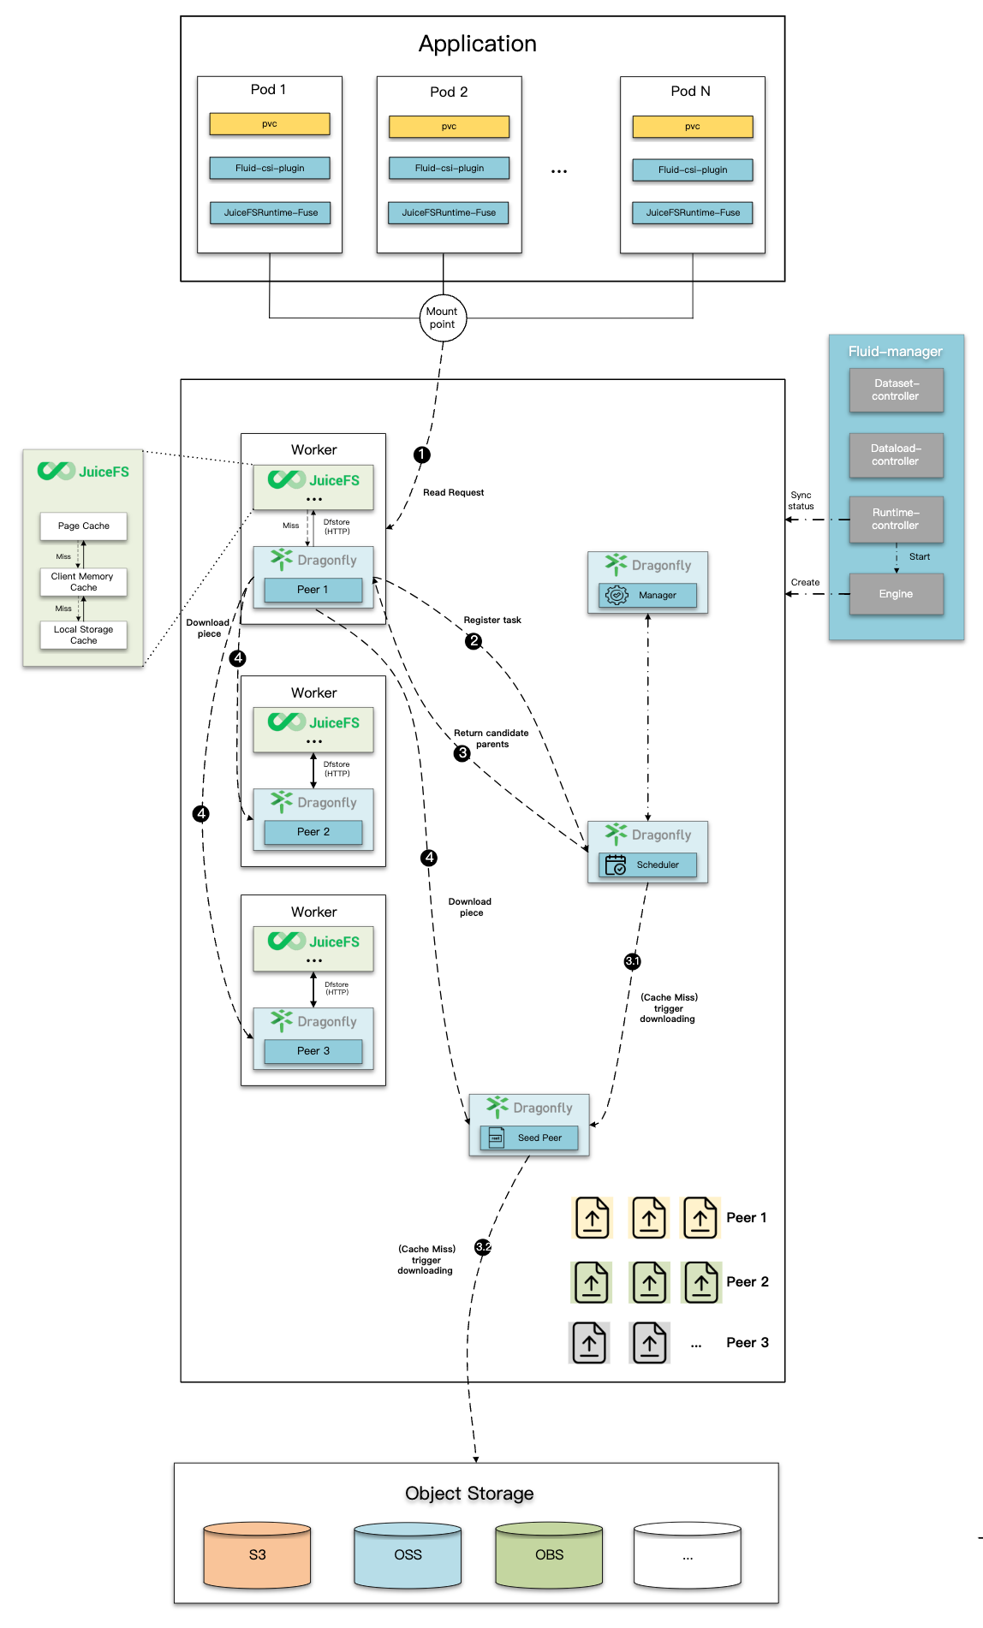
Exciting Updates
AI Training
The solution based on Fluid + JuiceFS + Dragonfly performs P2P distribution of the data set during the training process. Reduce the pressure on the origin site and improve loading speed.

Slide 11
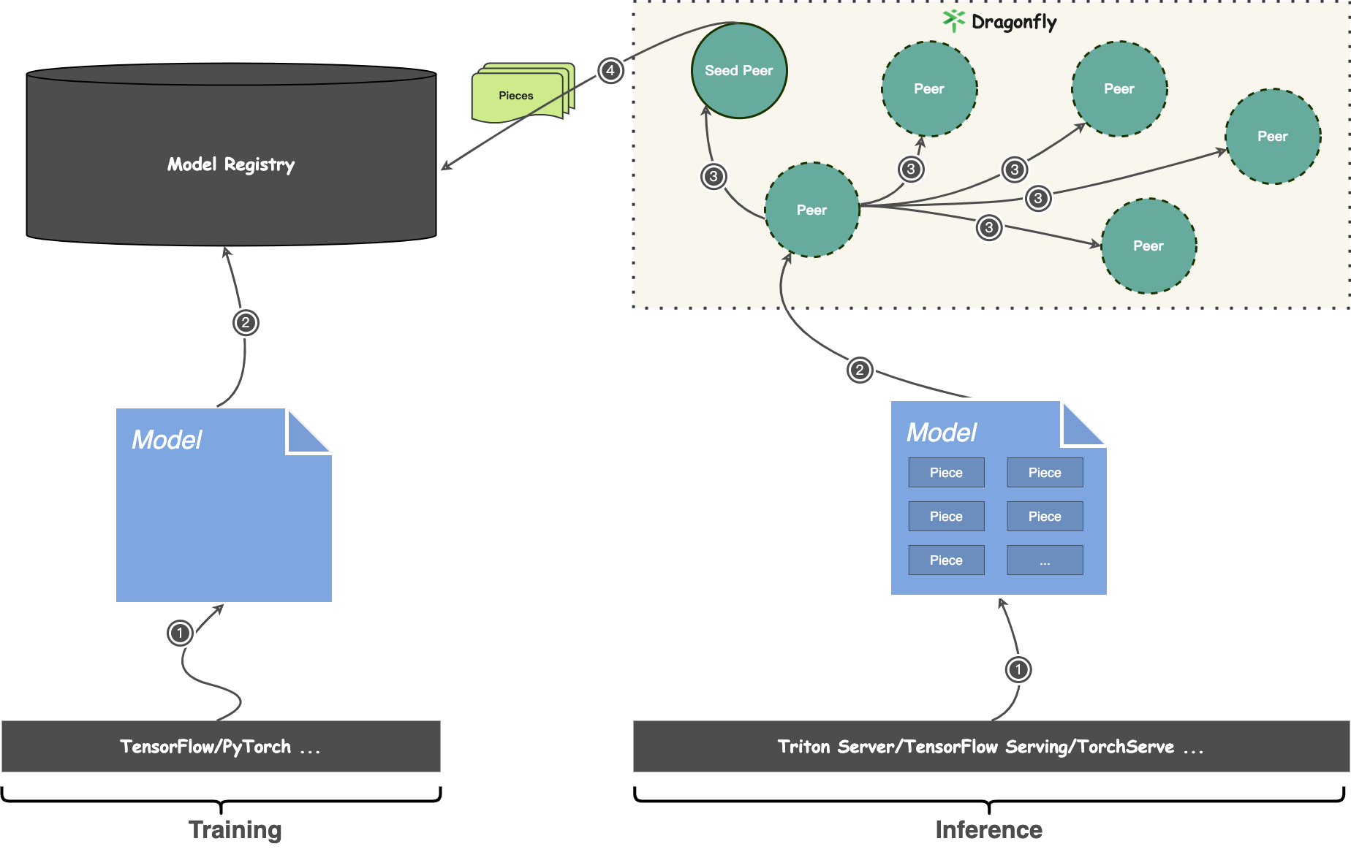
Exciting Updates
AI inference
P2P distribution: Use P2P technology to utilize the idle bandwidth of nodes, reduce the pressure on the origin site, and reduce network latency.
Integration with community inference frameworks is non-intrusive using Dragonfly.

Slide 12
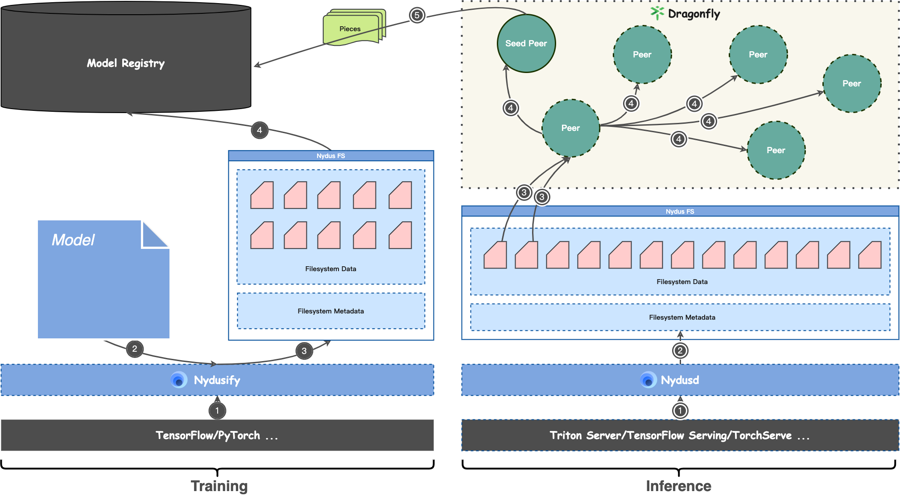
Exciting Updates
AI inference
Model file system: Use P2P technology to utilize the idle bandwidth of nodes, reduce pressure on the origin site, and reduce network latency.
Deduplication & compression reduces model size and saves model loading traffic.
On-demand loading capability, only loads part of the model data required for inference.

Slide 13
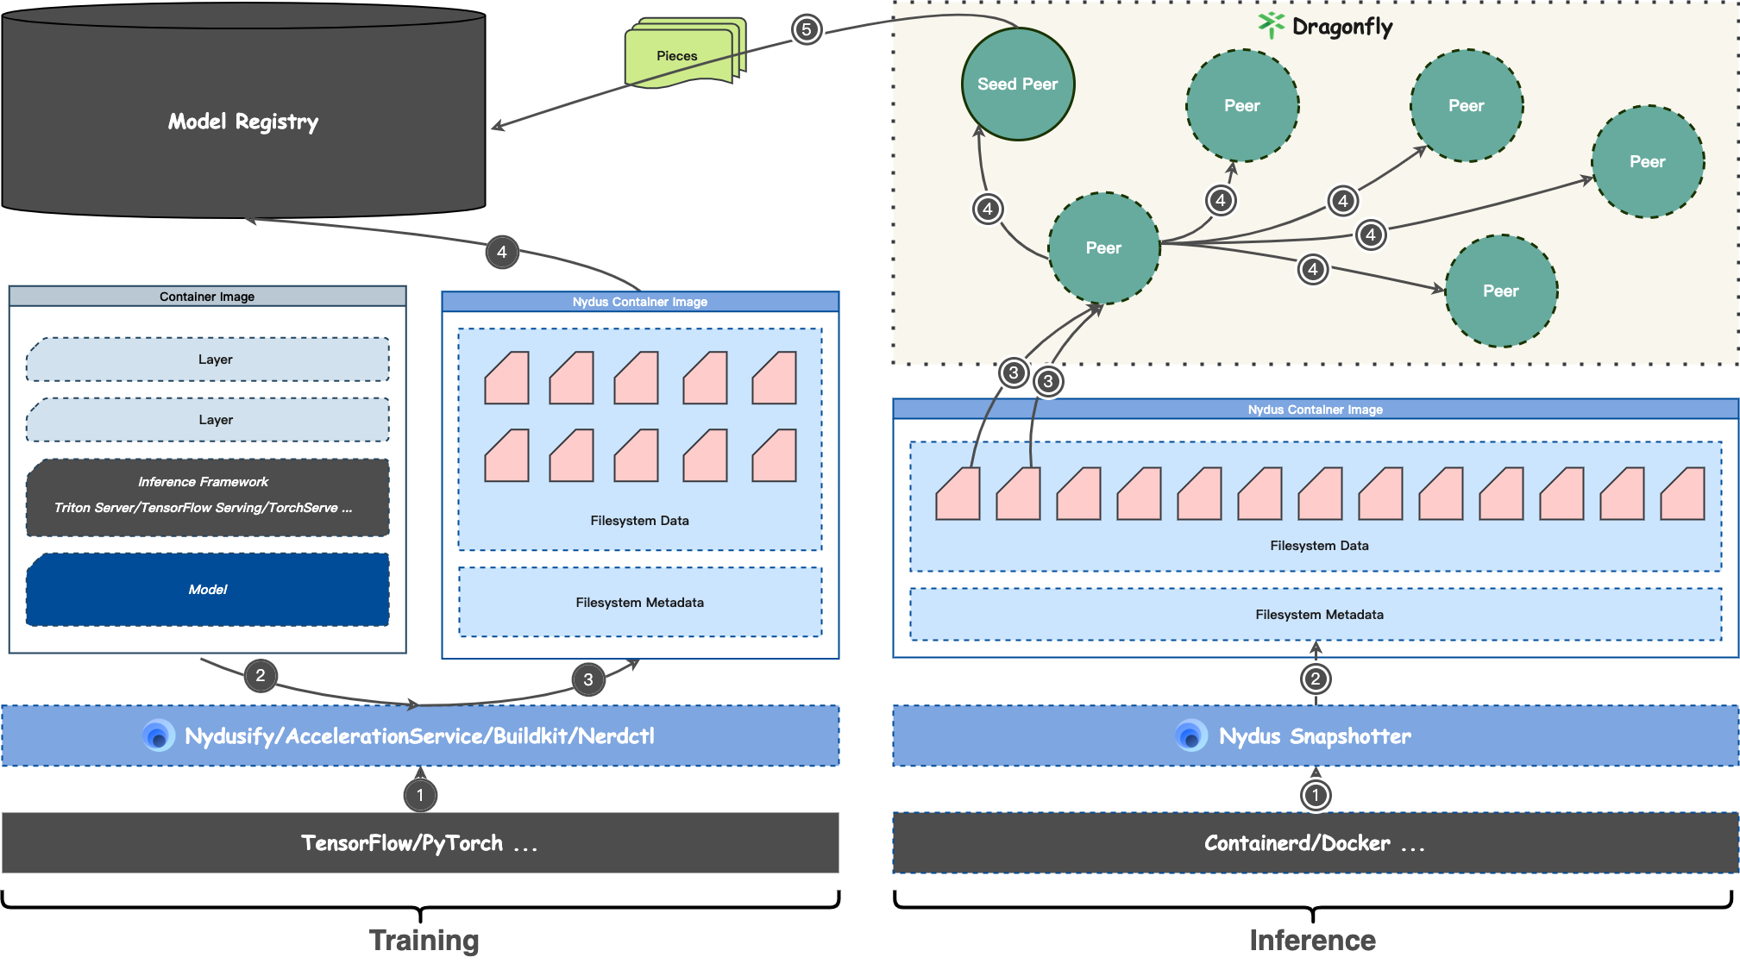
Exciting Updates
AI inference
Model mirroring: Use P2P technology to utilize the idle bandwidth of nodes, reduce pressure on the origin site, and reduce network latency.
Deduplication & compression reduces model size and saves model loading traffic.
On-demand loading capability, only loads part of the model data required for inference.
The image construction speed is better than other image compression formats.

Slide 14
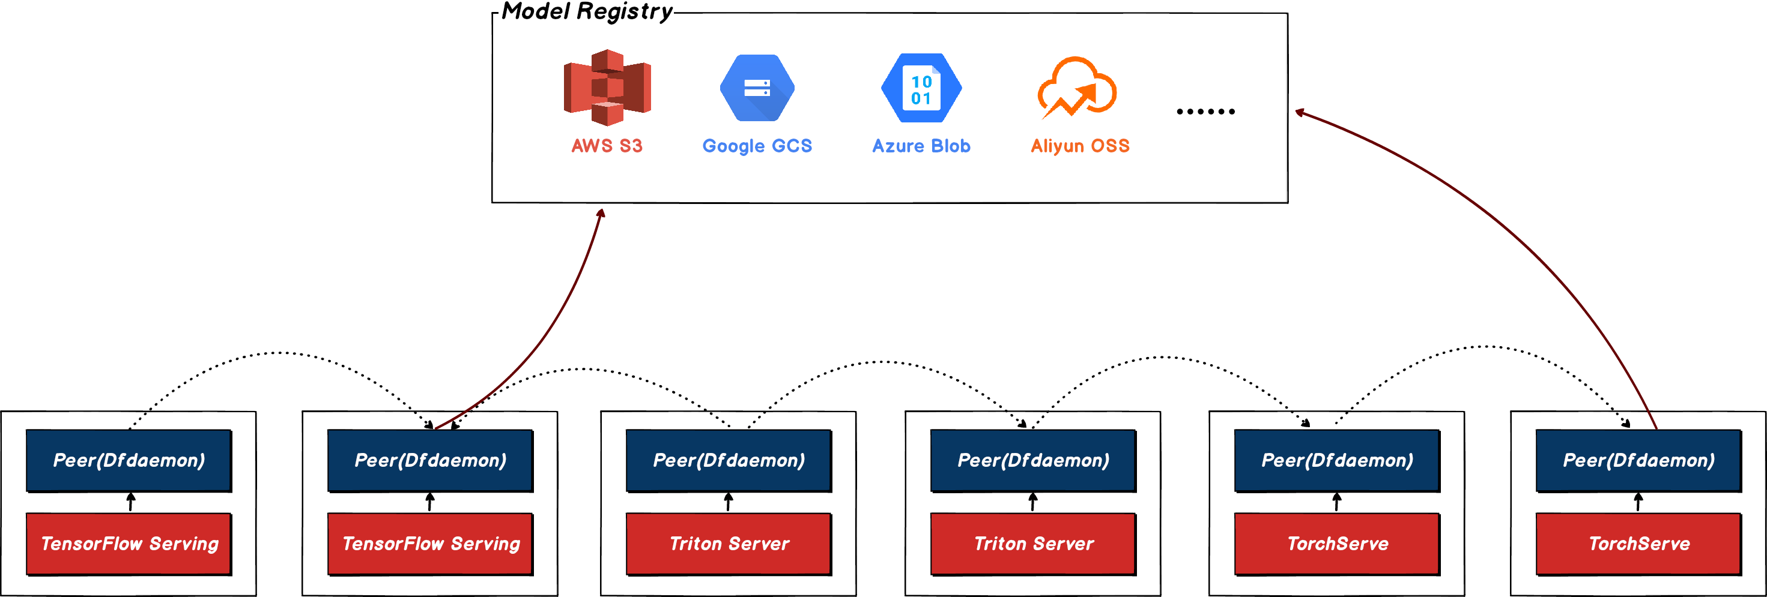
Exciting Updates

Slide 15
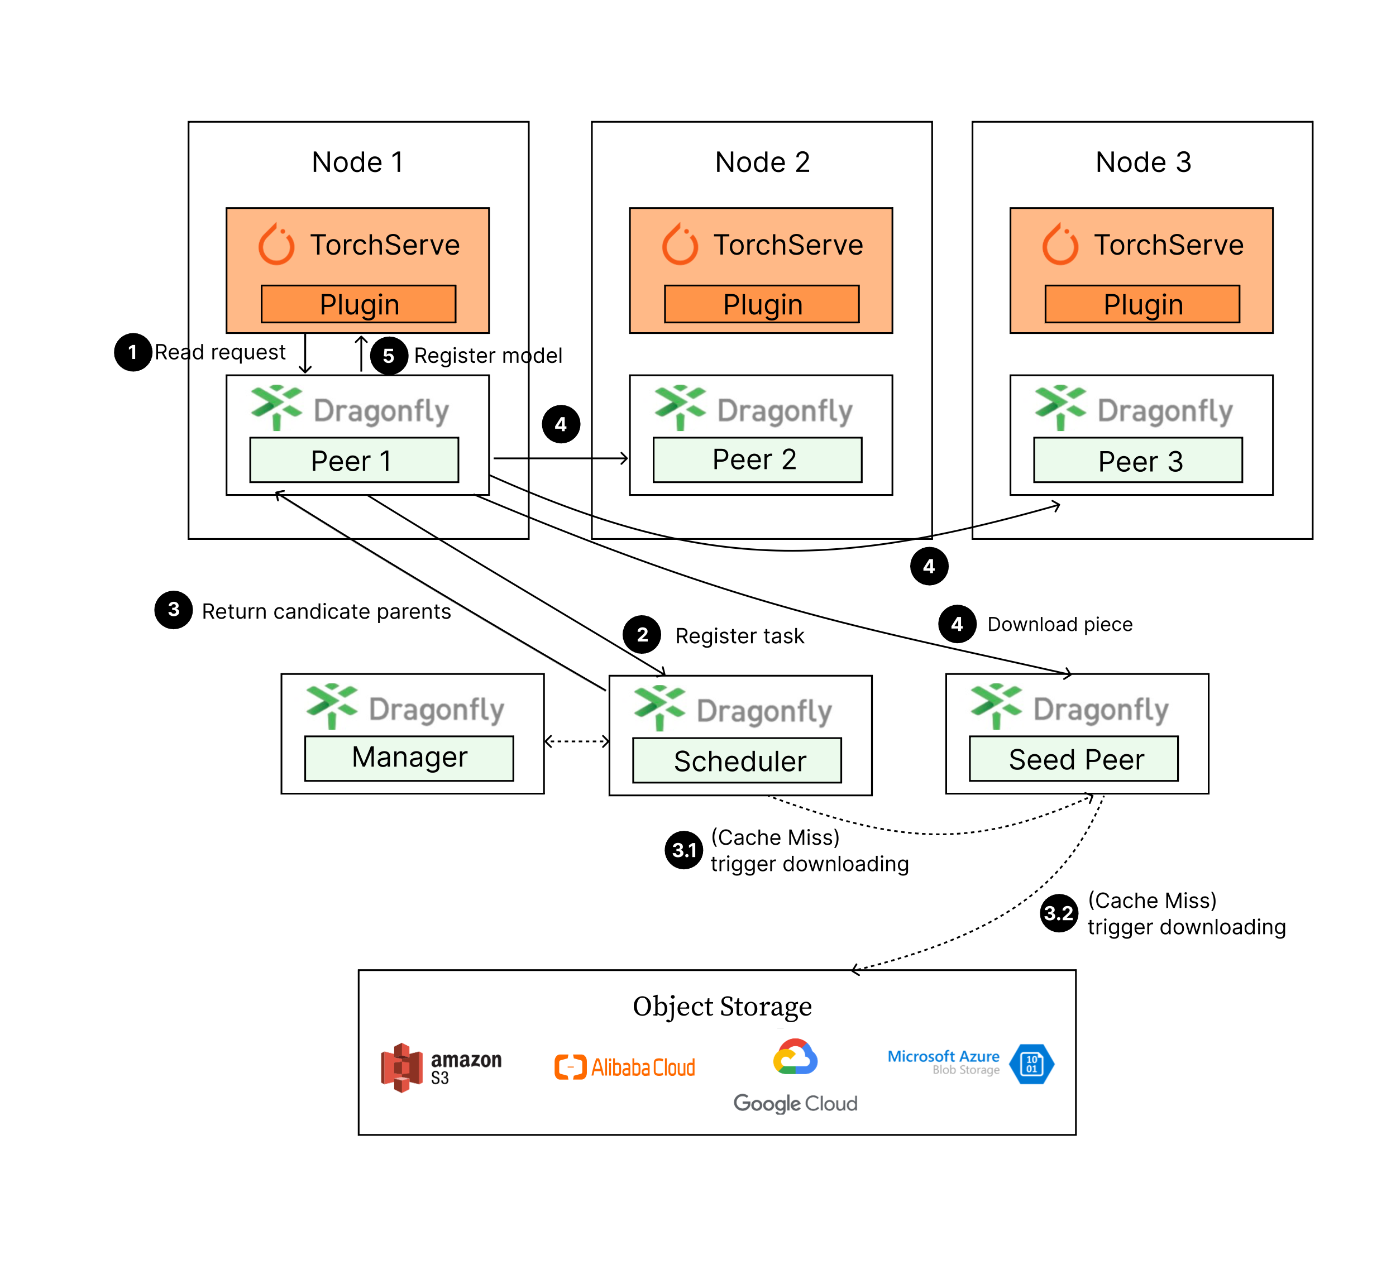
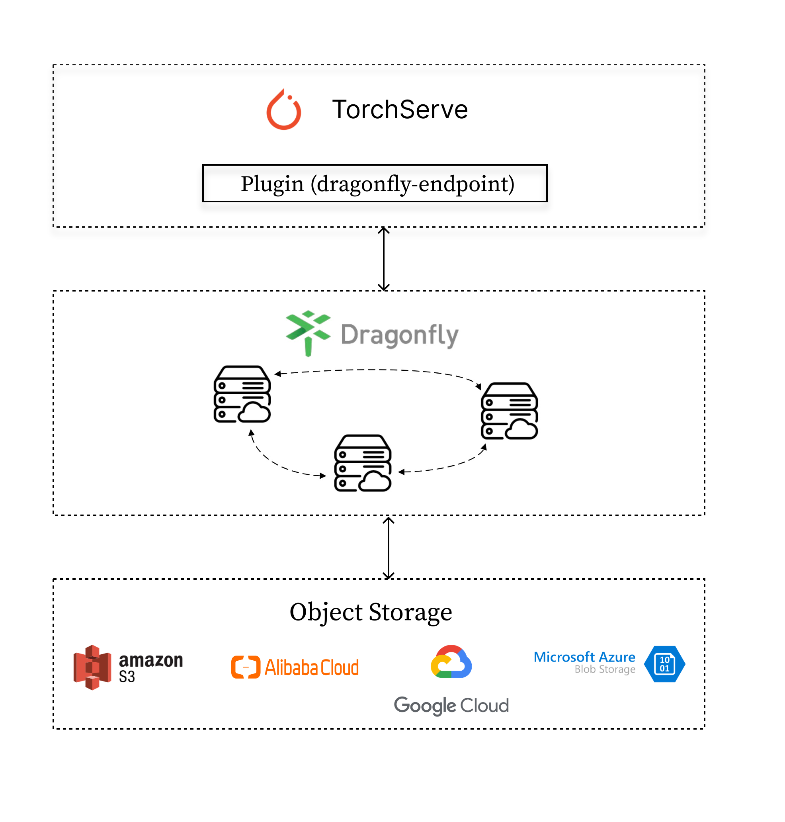
Exciting Updates
AI inference(TorchServe)

Slide 16
Exciting Updates
Framework
Other data
It can be downloaded directly through Dragonfly & Nydus mirror acceleration standard solution.
If it is a model image scenario, part of the framework data is actually already in the model image, and you can directly accelerate the image distribution.
It can be built into the image and directly accelerated image distribution.
Files can also be accelerated and distributed directly through P2P.

Slide 17
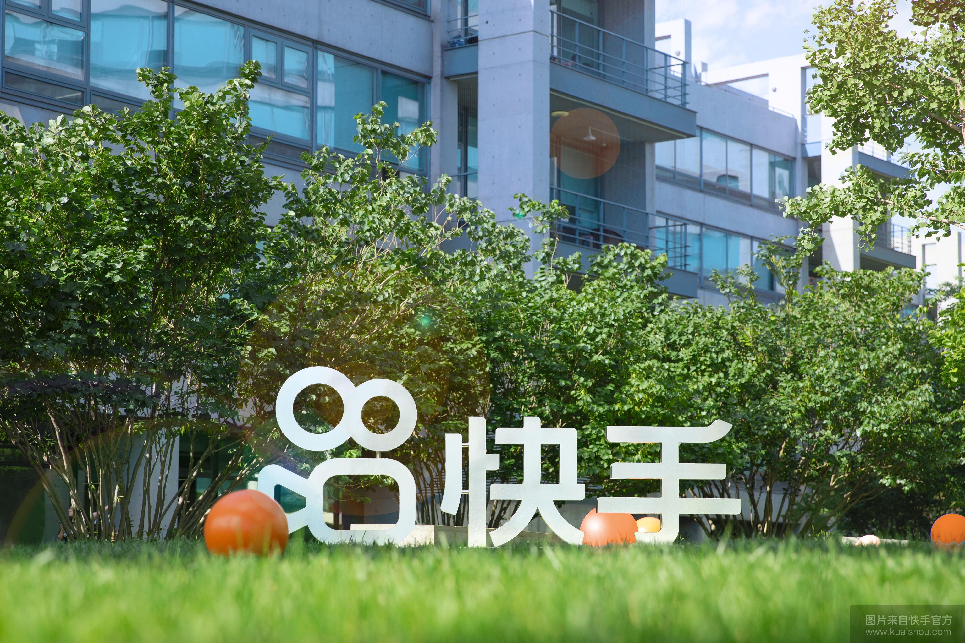
AI model distribution in the Kuaishou
Kuaishou AI model distribution practice sharing

Slide 18
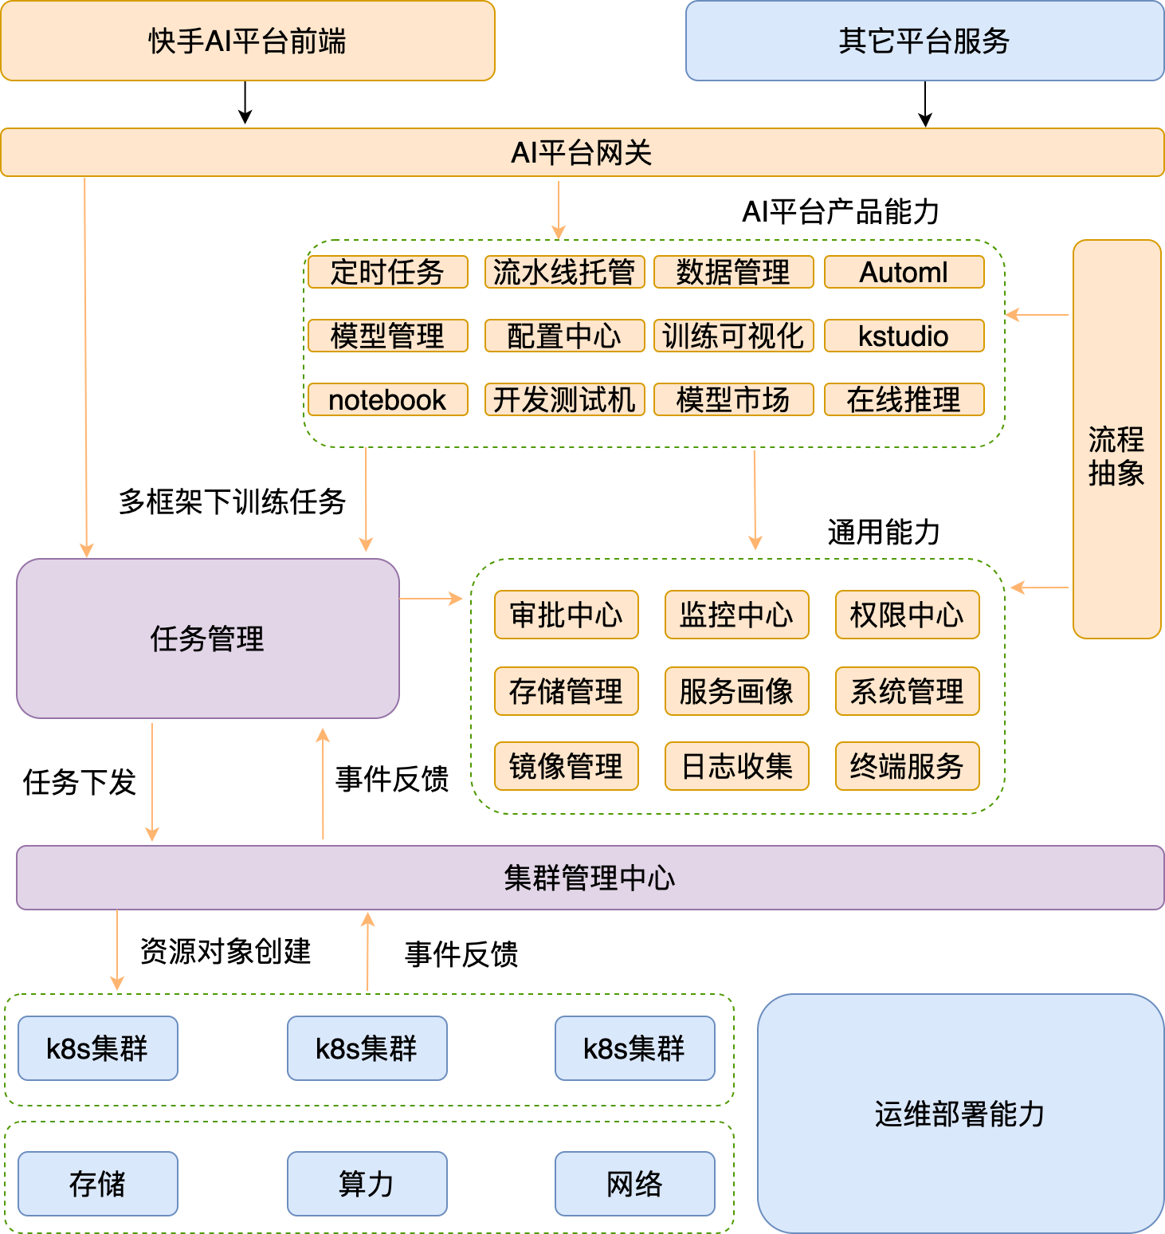
AI model distribution in the Kuaishou
Introductio to Kuaishou AI Platform
Kuaishou AI Platform，As a unified machine learning platform in the company，using k8s as the basic infrastructure, it supports the company's algorithm code development, model training, model launch, model market, online reasoning and so on.
The main responsibility of the entire platform system is to receive AI training tasks from various scenarios upwards, such as pipeline tasks, scheduled tasks, data processing, studio, automl, to shield low-level resource information downwards and conduct unified management of the life cycle of tasks.

Slide 19
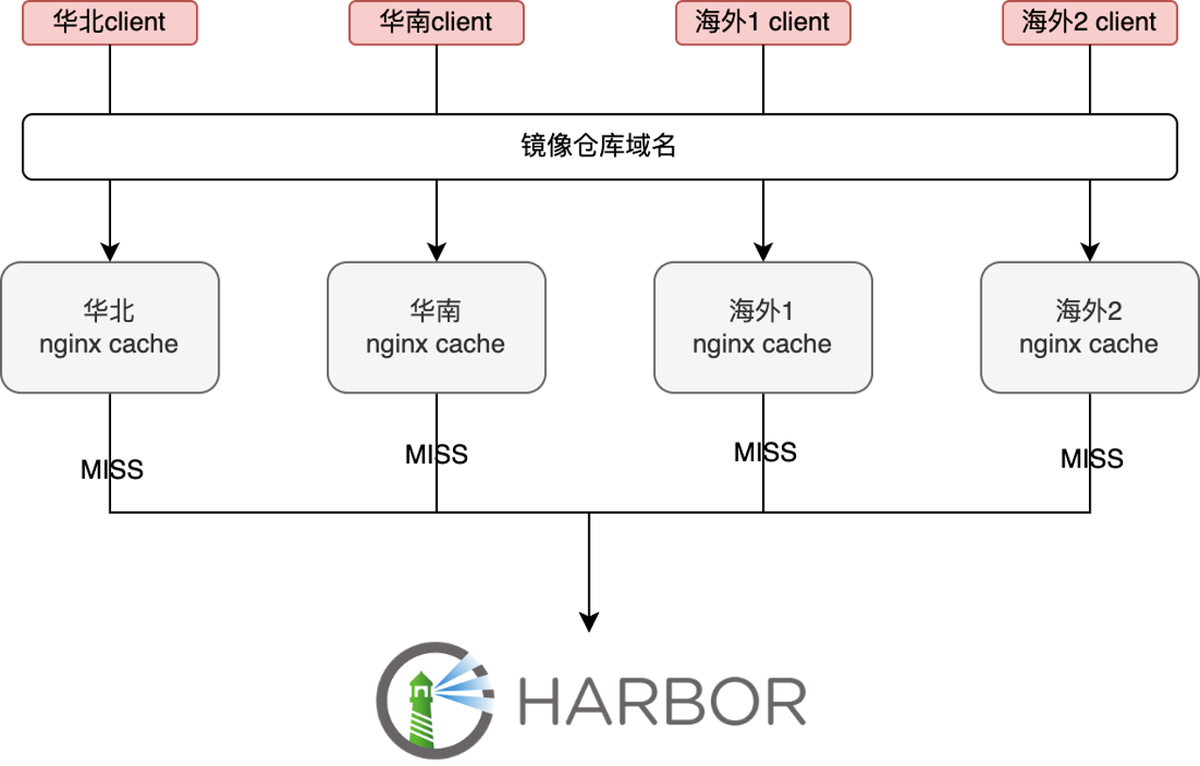
AI model distribution in the Kuaishou
Introduction to Kuaishou Image Distribution
Kuaishou Image Registry, as a unified image management platform within the company, supports the storage and management of all container images in the company.
The crucial ability is implemented based on Harbor, and nginx caches are built domestically and overseas region to accelerate the pulling of corresponding regional images.
At Kuaishou, the average image size is about 3.5G, among which the average size of AI-type images is as high as more than 30G. The images of more than 40G are also very common.

Slide 20
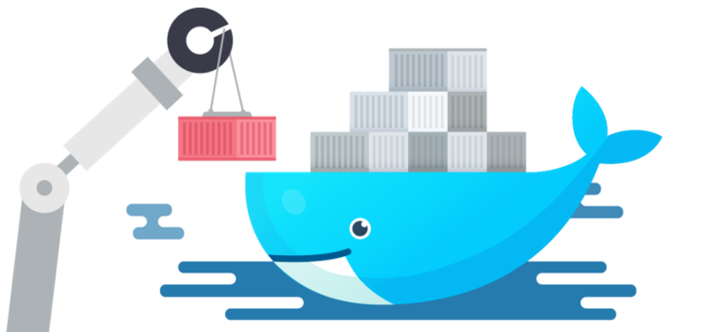
AI model distribution in the Kuaishou
Kuaishou AI model image distribution pain points
The AI image is large(average 30G or more) —— The image pulling phase during instance startup is very time-consuming( >10min )
Training tasks are started centrally(concurrency 100~1000+) —— Harbor network traffic bandwidth is full
Single node instantaneous/continuous high IO —— Impact and interference on the stability of other businesses

Slide 21
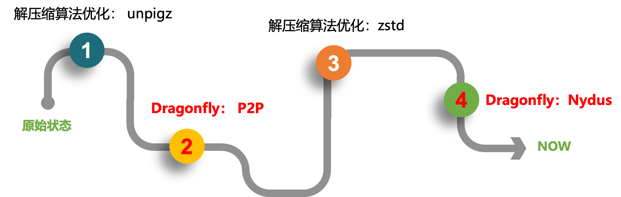
AI model distribution in the Kuaishou
Kuaishou AI model image distribution optimization process

Slide 22
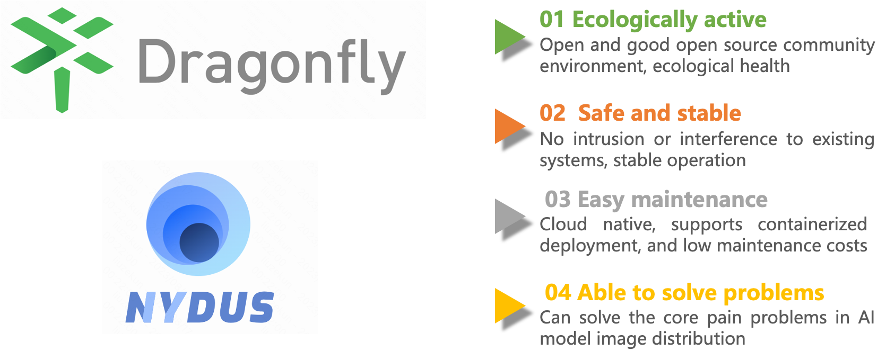
AI model distribution in the Kuaishou
Kuaishou AI model image distribution technology selection

Slide 23
AI model distribution in the Kuaishou
Kuaishou AI model image distribution technology selection
Why is Model Image
Low investment cost: There is no need to invest additional manpower to be responsible for the development and maintenance of the model management system, and there is no need to invest additional resources to build the system. The container cloud already has image management and distribution capabilities, and AI models such as internal AI model market and model distribution can be completed at low cost. management needs.

Slide 24
AI model distribution in the Kuaishou
Kuaishou AI model image distribution technology selection
Why is Model Image
Convenient delivery: The image warehouse is a company-level service that is released through image model products. It is very suitable for cross-team delivery and model sharing within the company, especially when the business has been containerized.

Slide 25
AI model distribution in the Kuaishou
Kuaishou AI model image distribution technology selection
Why is Model Image
Data sharing: Thanks to the reuse of container image layers and mechanisms such as deduplication and compression of image data chunk granularity, model loading traffic and back-end data storage pressure can be saved.

Slide 26
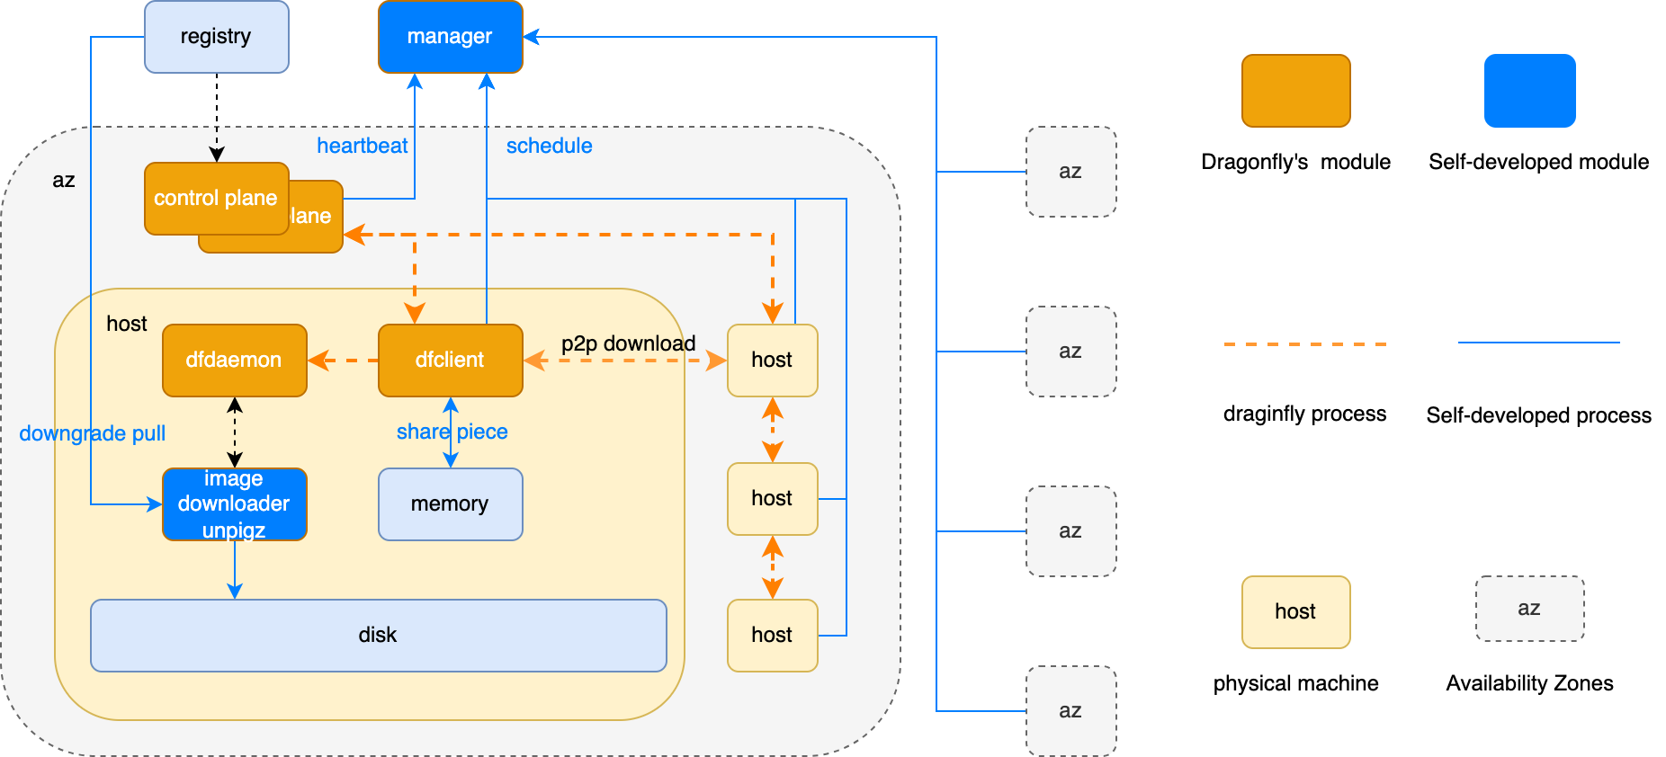
AI model distribution in the Kuaishou
Dragonfly AI model image distribution practice
Control Plane's stability
Kuaishou Container Cloud has nearly hundreds of thousands of hosts, and there are many important service deploy activities every moment, such as e-commerce promotions, Simba live broadcast events, celebrity meetings, etc., all of which require rapid expansion, image distribution and access After Dragonfly, it can be said that the entire company's business deploy is bet on Dragonfly. Therefore, the stability requirements for the control plane are extremely important. For this, we must adopt a multi-AZ deployment architecture. AZs are equipped for each other. The control plane has automatic scheduling and automatic offloading mechanisms, and can quickly stop losses when exceptions occur.

Slide 27
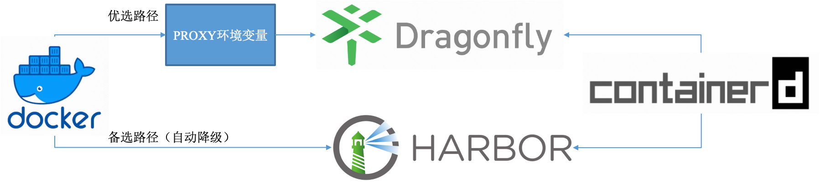
AI model distribution in the Kuaishou
Dragonfly AI model image distribution practice
Node's stability
In the specific practice of the stand-alone dimension, Kuaishou has passed in-depth evaluation tests and found that P2P image pulling is also a process that may consume heavy CPU and memory resources, and is very likely to cause stability interference to the stand-alone business. Therefore, it is highly recommended that dfdaemon and dfget are used in In the k8s cluster, daemonset resource containerization is deployed to isolate and limit CPU/memory resources to avoid affecting business operations.
At the same time, the container engine image pulling strategy is supplemented with a downgrade strategy to ensure that when the control or stand-alone Agent component is abnormal, the image pulling is quickly returned to the source and is foolproof.

Slide 28
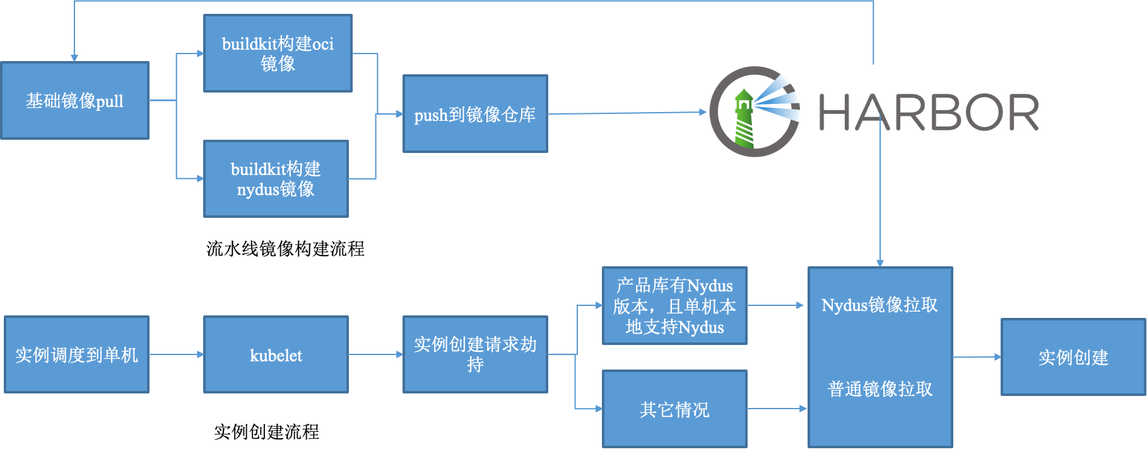
AI model distribution in the Kuaishou
Dragonfly AI model image distribution practice
Image build and business use
Kuaishou Container Cloud is huge in scale. When introducing the Nydus mirroring solution, smooth switching and smooth transition must be considered. The problems we faced are:
It is not possible to directly promote the full deployment of single-machine Nydus components.
There is no way to directly require businesses to use Nydus format images directly.

Slide 29
AI model distribution in the Kuaishou
Dragonfly AI model image distribution practice
Effect Summary
Harbor warehouse export network bandwidth pressure saves an average of 70% | Harbor warehouse export network bandwidth peak pressure saving 80% | Image pulling time is saved by 90% | POD instance startup takes an average of 50%
https://www.cncf.io/case-studies/kuaishou-technology/

Slide 30




AI model distribution in the Kuaishou
Dragonfly Github
Dragonfly Website
Nydus Github
Nydus Website

